Slide 1
CS0112 Python Gearup

Slide 2
Python Intro
What is Python?
A popular programming language used for variety of things: web development, software development, mathematics, system scripting.
In CS112, we’ll only be using Python.
Can be treated in an object-oriented way or a functional way.

Slide 3

Syntax
Python has a simple syntax similar to the English language.
Python uses new lines to complete a command, as opposed to other programming languages that often use semicolons or parentheses.
Python relies on indentation, using whitespace, to define scope; such as the scope of loops, functions and classes.

Slide 4
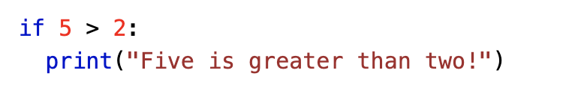
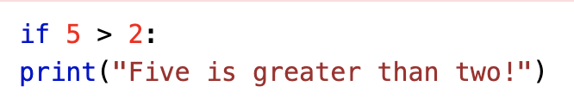
Indentation Examples
Correctly indented:
Error:

Slide 5
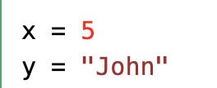
Variables
No need to declare type! Just assign a value to a variable.
Variables have scope - for example, if you declare a local variable inside a function, they may not be shared with other functions.

Slide 6
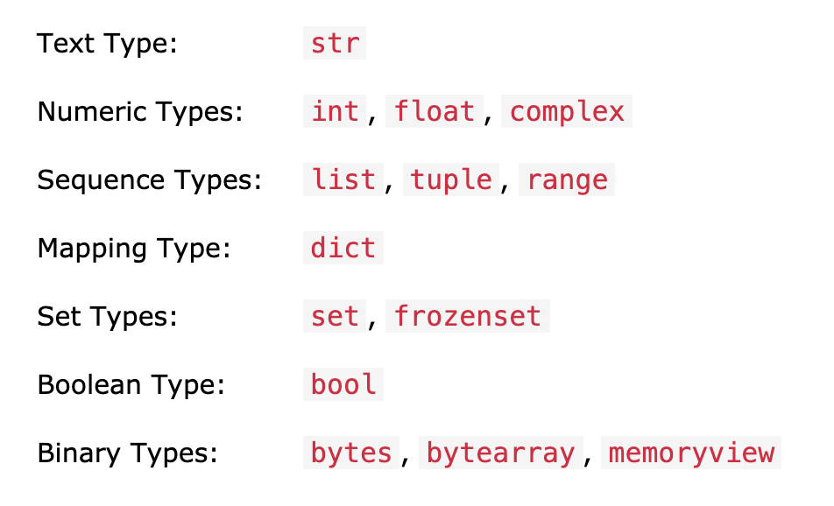
Data Types
Built-in types in Python
In programming, data type is an important concept.
Variables can store data of different types, and different types can do different things

Slide 7
Lists (list)
Store 0 or more data points, in a specific order
Ex:
[]
[“one element”]
[5, 8, 9, -23]
Testing Tip: always test your functions on empty lists, single-element lists, and large lists (and more)
Unless otherwise specified (i.e. if we say “do not worry about empty lists for this function”)

Slide 8
Lists (list)
Documentation: https://docs.python.org/3/tutorial/datastructures.html
Warning: if you scroll down, it talks about “stacks” and “queues”
Do not need to worry about those for cs112
Because of order, it’s possible to index into a list
The first element if at index 0, second at index 1, third at index 2, etc
“A”
“B”
“C”
“D”
Index 0
Index 1
Index 2
Index 3

Slide 9
Helpful list functions
list.append(x): adds an element to the end of the list
Ex: [5, 6, 7, 8].append(9) returns [5, 6, 7, 8, 9]
list.insert(i, x): inserts x into the list at index i
x will be at index i in the result list
Ex: [“cat”, “dog”, “banana”].insert(2, “cow”) returns [“cat”, “dog”, “cow”, “banana”]
list.remove(x): removes the first instance of x from the list
Ex: [0, 1, 0, 1, 0].remove(1) returns [0, 0, 1, 0]

Slide 10
List Concatenation
+ operator appends a full list
Example:
[“a”, “b”, “c”] + [“d”, “e”, “f”] = [“a”, “b”, “c”, “d”, “e”, “f”]

Slide 11
Sets (set)
Store groups of data, like lists
However, they have no official ordering
No duplicates
No indexing
{“a”, “b”, “c”, “a”, “b”} = {“a”, “b”, “c”} = {“b”, “c”, “a”}
Cool operations:
Union: {1, 2, 3} | {4, 5} = {1, 2, 3, 4, 5}
Intersection: {“a”, “b”, “c”, “d”} & {“e”, “d”, “c”} = {“c”, “d”}
Difference: {5, 6, 7, 8} - {4, 5, 6} = {7, 8}
Docs: https://docs.python.org/3/library/stdtypes.html#set-types-set-frozenset

Slide 12
Sets (set)
Important: although { and } are used to display sets, {} is not the empty set - it is the empty dictionary
Use set() to create the empty set
Pop method:
set.pop() returns an element and updates the set to not contain that element
Demo Time

Slide 13
Dictionaries (dict)
Store a set of key-value pairs
Use the key to look up its values
Ex:
{}
{“a”: 1, “b”: 0, “c” : 2, “d” : 1}
Use key to lookup value:
example = {“a”: 1, “b”: 0, “c” : 2, “d” : 1}
example[“a”] = 1, example[“b”] = 0, etc

Slide 14
Useful dict functions
Docs: https://python-reference.readthedocs.io/en/latest/docs/dict/
dict.keys(): returns the list of the dict’s keys
{0: [“a”, “b”], 1: [“c”], 2: [], 3: [“a”, “b”]}.keys() = dict_keys([0, 1, 2, 3])
dict.values(): returns the list of the dict’s values
{0: [“a”, “b”], 1: [“c”], 2: [], 3: [“a”, “b”]}.values() returns
dict_values([ [“a”, “b”], [“c”], [], [“a”, “b”] ])
dict.has_key(key): returns true if the given key is a key in the dict, false otherwise
{0: [“a”, “b”], 1: [“c”], 2: [], 3: [“a”, “b”]}.has_key(4) = false
{0: [“a”, “b”], 1: [“c”], 2: [], 3: [“a”, “b”]}.has_key(0) = true

Slide 15
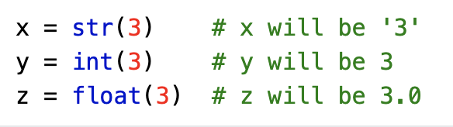
Casting
You can cast variables in Python, meaning you can change their data type to another with the same information. This will be very useful!

Slide 16
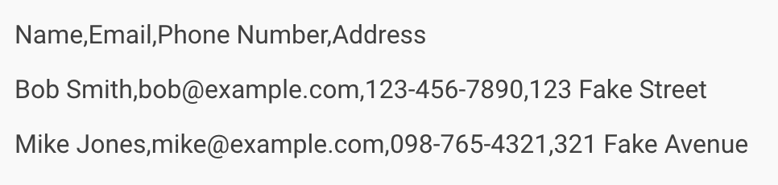
For HW 1: CSV Files (1)
A CSV file (comma-separated values file) has a fairly simple structure.
It’s a list of data separated by commas.
For example, let’s say you have data structured like this. This is a CSV file.

Slide 17
CSV Files (2)
CSV files can be more complicated (it can contain thousands of lines, more entries on each line, or long strings of text).
CSV files are designed to be a way to easily export data and import it into other programs.
The resulting data is human-readable and can be easily viewed with a text editor like Notepad or a spreadsheet program like Microsoft Excel.
In Homework 1, you’ll be practicing how to manipulate data from a CSV file and process it the way you want!

Slide 18
Demo Time!

Slide 19
Helpful Resources
w3schools: https://www.w3schools.com/python/default.asp
Online Tutorial: https://www.youtube.com/watch?v=rfscVS0vtbw

